Slide 1
Jermyn Borough Council Meeting
6/18/2026

Slide 2
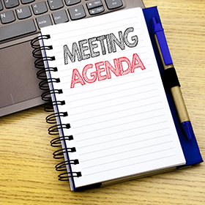
Meeting Agenda
JUNE 18, 2026
CALL TO ORDER
PLEDGE OF ALLEGIANCE
ROLL CALL
PREVIOUS MEETING MINUTES
TREASURE REPORT/BILLS PAYABLE
CORRESPONDENCE
SECRETARY REPORT
PUBLIC COMMENT
PROFESSIONAL REPORTS
  MAYOR/POLICE/250 UPDATE
  SOLICITOR
  FIRE CHIEF
  TAX COLLECTOR
  KBA
  EMA
COMMITTEE REPORTS
  SAFETY
  FINANCE
  SHADE TREE
  RECREATION
  NORLACK
MOTION TO HAVE SOLICITOR PREPARE E-BIKE ORDINANCE
MS4 ORDINANCE 07-2026
POLICE PENSION ORDINANCE 08-2026
RESOLUTION FOR ARTISAN GRANT 09-2026
SAFE STREETS RESOLUTION 10-2026
DPW BLDG CEILING BIDS
CODE OFFICER APPOINTMENT
OLD MILL TREE ISSUE
NEW BUSINESS
ADJOURNMENT

Slide 3
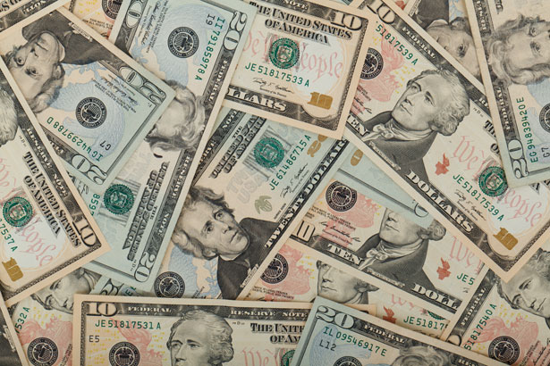
Treasurer’s report
5/21/2026
ASSETS
Checking/Savings
American Rescue Plan Fund 92,617.22
Capital Reserve - DPW 1,300.28
Capital Reserve - Police 5,289.82
Crime Watch Fund 222.69
General Fund - Community 261,195.67
General Fund - FNB 11,686.54
Holiday Lights Fund 400.59

Slide 4
Treasurer’s report
Investment - General Fund 1,191.72
Investment - Liquid Fuels 26,244.20
Investment - Paving Fund 1,203.97
Investment - Recycling 130.84
Investment - Refuse 187.82
Liquid Fuels - FNB 34,366.56
Petty Cash 194.00
Recreations Fund 18,939.62
Recycling - Community 10,141.26
Refuse Checking - FNB 312,175.86
Total Checking/Savings 777,488.66

Slide 5
Treasurer’s report
200000 · Accounts Payable 12,442.17
Long Term Debt 415,300.00

Slide 6


